Slide 1
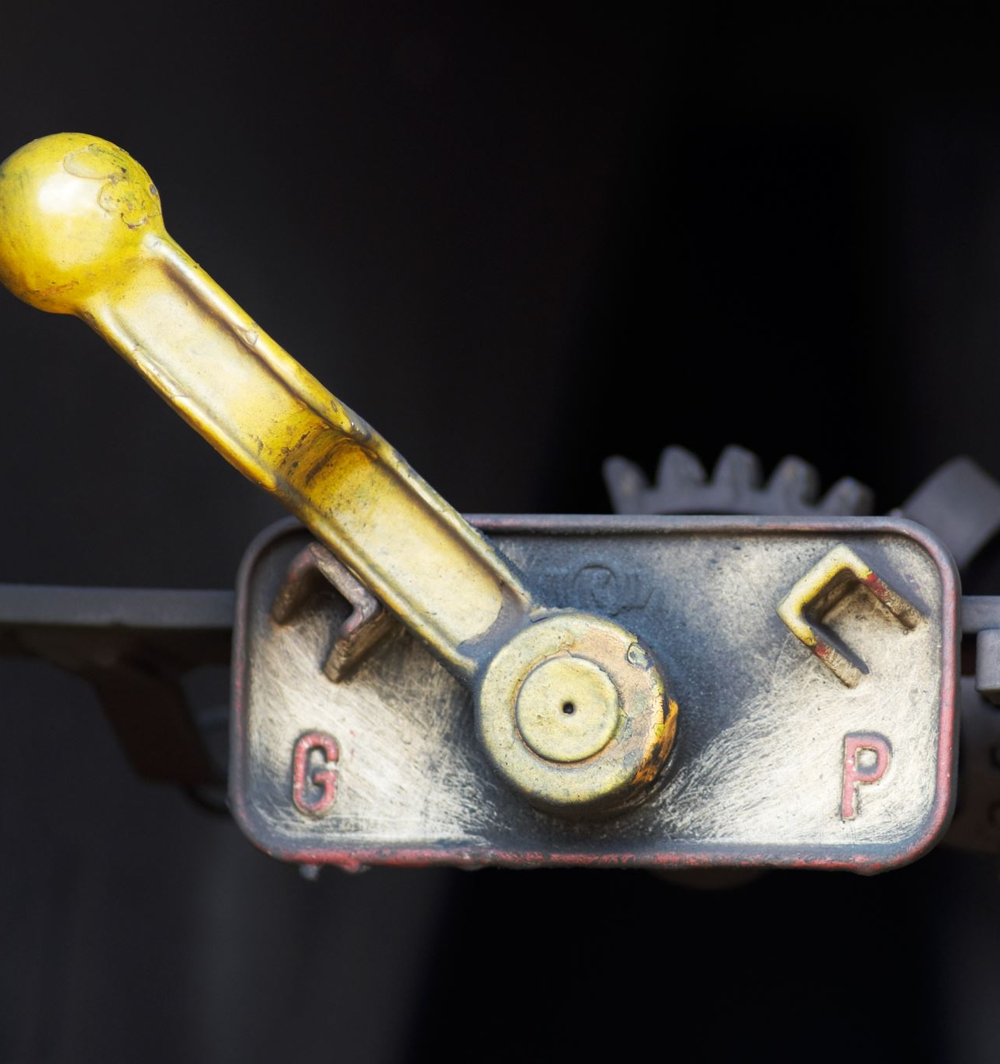
Lever Mechanism

Slide 2
What is a Lever?
A lever is a simple machine consisting of a beam or rigid rod pivoted at a fixed hinge, or fulcrum, used to transfer a force to a load and usually to provide a mechanical advantage.
A lever is a rigid body capable of rotating on a point on itself. On the basis of the locations of fulcrum, load, and effort, the lever is divided into three types.

Slide 3
Parts of a Lever:
Fulcrum – the point at which the lever rotates.
Input force (also called the effort) – the force applied to the lever.
Output force (also called the load) – the force applied by the lever to move the load.

Slide 4
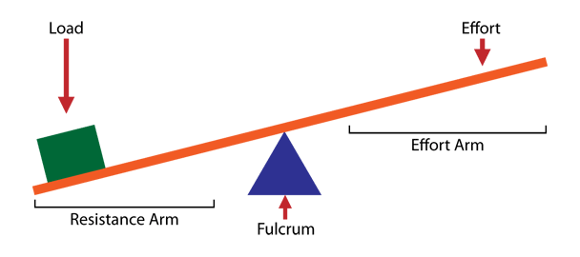
Lever Mechanism:

Slide 5
Types of Lever
On the basis of the location of fulcrum ,load and effort ,the lever is divided into three parts
First- class Lever
Second -class Lever
Third-class Lever
s,

Slide 6
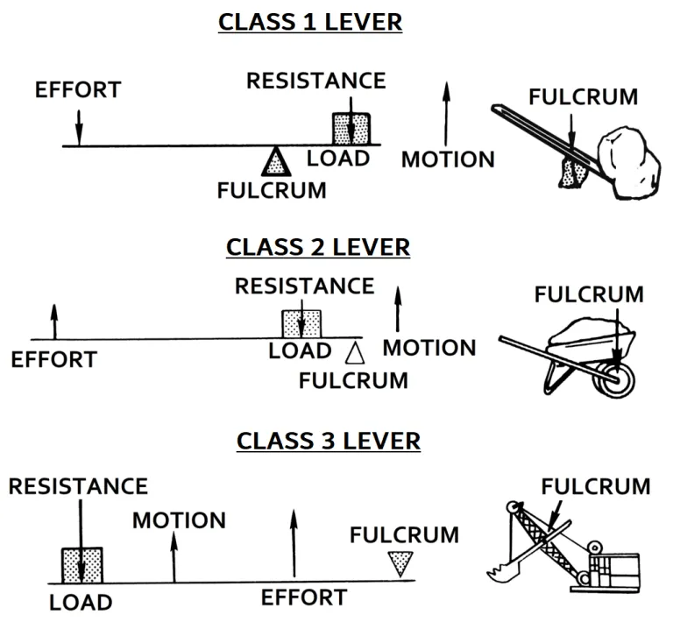

Slide 7
First-class levers: have the fulcrum between the effort (force) and the load to resemble a see -saw. Examples of first-class levers are pliers, scissors, a see-saw, and a weighing balance.
Second –Class Lever: In second class levers, the load is between the effort (force) and the fulcrum A common example is a wheelbarrow where the effort moves a large distance to lift a heavy load, with the axle and wheel as the fulcrum.other examples are nutcracker,bottle opner and conventional door.
Third –Class Lever: With third-class levers, the effort is between the load and the fulcrum.Examples: tweezers ,fishing rods ,hammers and barbecue tongs.

